Slide 1


AMAZON SALES ANALYSIS
Wireframe Documentation
Created by-Himanshu Pewal

Slide 2
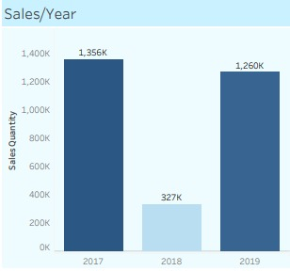
REPORTS:
As per the problem statement, we have created yearly and Monthly sales Trend:
1. Yearly Trends for Sales Quantity.
Yearly Sales chart gives an insight into the trend of sales past three years. The visual shows drop in sales in 2018 because we have data for only first 3 months of 2018.

Slide 3
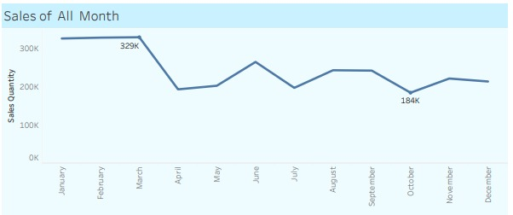
2. Monthly Trend for Sales Amount: .
In this chart, we see the split up of total sales by months. This helps us understand highly active period for sales.

Slide 4
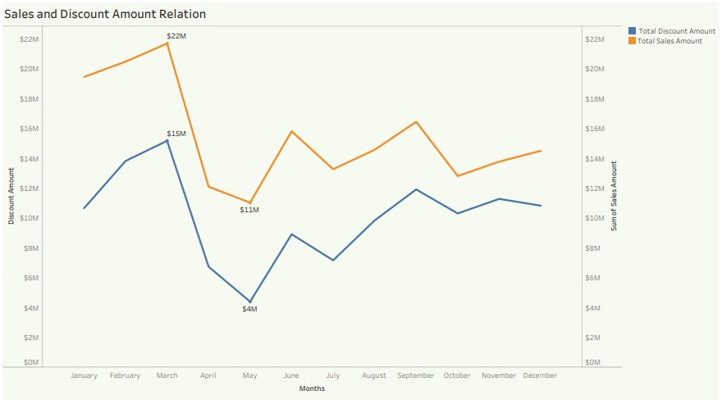
3. Relationship between Discount amount and Sales amount:
Increase in the discount amount has led to increase in the Sales amount as well. Typical time period of Amazon Shopping Sales is around June, August, November and June. The Shopping Sale boosts sales amount

Slide 5
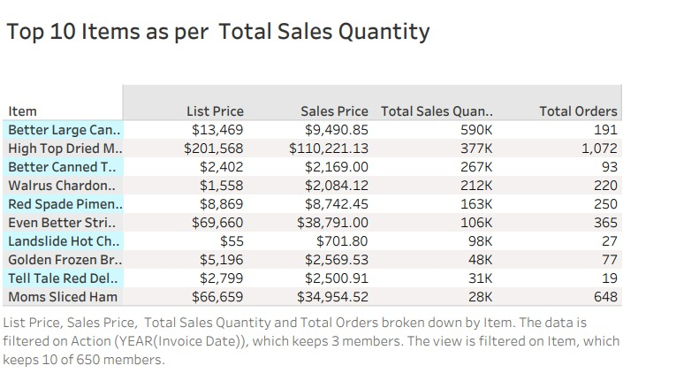
4. A table for frequently ordered items:
The table lists top 10 items according to orders and sales quantity. 'High Top Dried Mushrooms' has the highest number of orders because it was listed at a huge discount price.

Slide 6
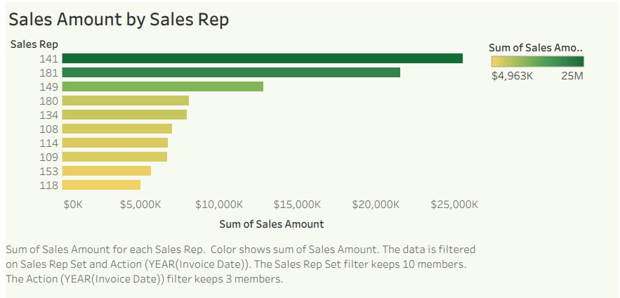
5. Top Performing Sales Representatives:
The chart shows top sales representatives making highest business for the company. Sales Representative Ids ‘141’ and ‘181’ have achieved highest number of sales.

Slide 7
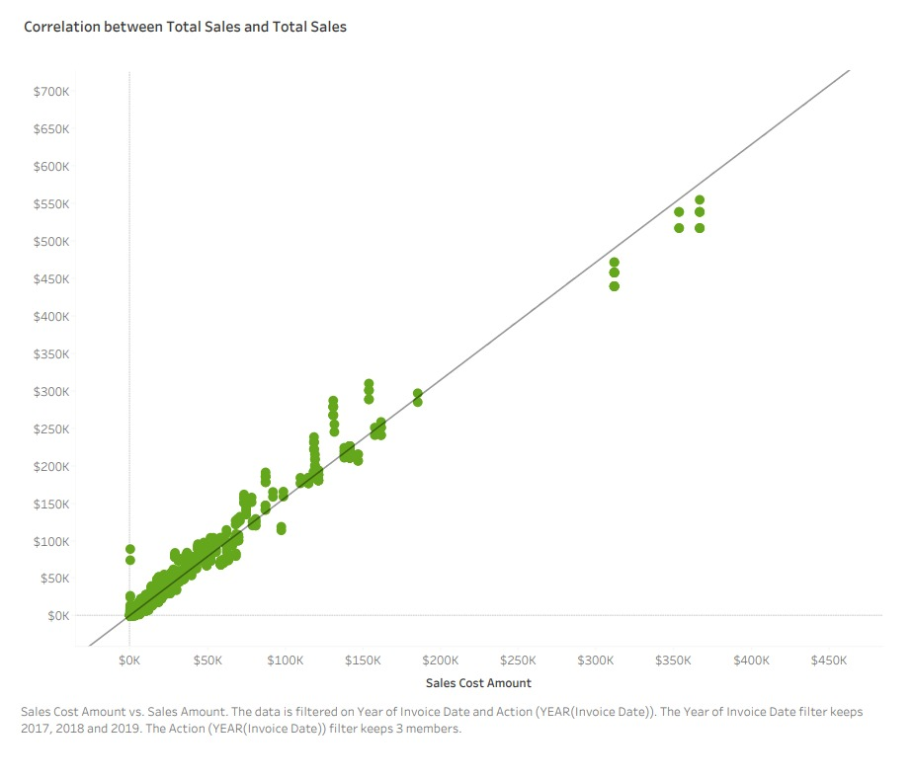
6. Relationship between Sales Cost and Total Sales:
The relationship chart between Sales Cost and Total Sales show a positive relationship. As the Sales Cost increases number of sales also increases.

Slide 8
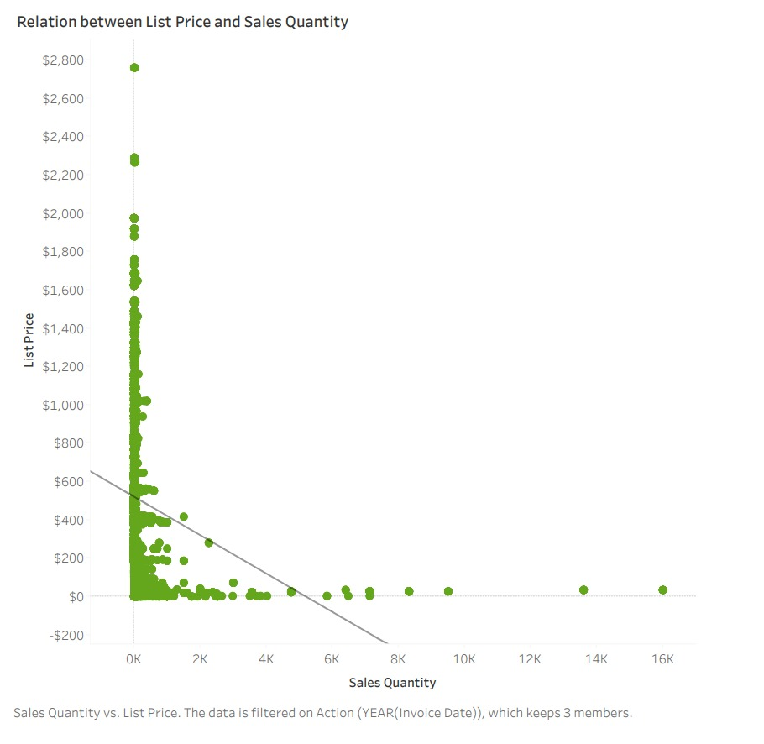
7. Relationship between Sales Quantity and List Price
The relationship chart confirms that there is no relationship between List Price and Sales Quantity. Fewer list prices don’t mean the sales will be higher.

Slide 9
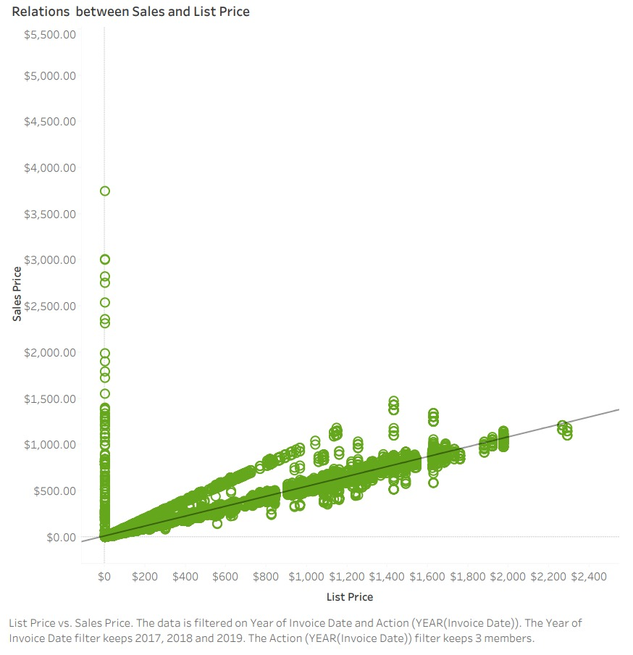
8. Relationship between Sales Price and List Price:
The chart displays almost a perfect straight line for Sales Price and List Price. Barring few points, the discount amount is marginal for most of the items

Slide 10
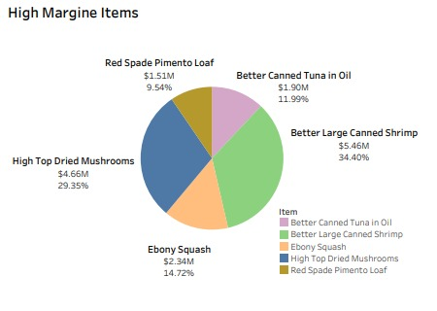
9. High Margin Items:
The donut chart displays 5 high margin items that helps us generate more profit for the company. ‘Better Large Canned Shrimp’ and ‘High Top Dried Mushrooms’ are two items company should look to sale more in future

